Slide 1







An Autonomous Institution
Department of Artificial Intelligence And Data Science
MINI PROJECT PHASE -IV
HYBRID FEDERATED GENERATIVE AI WITH ADVERSARIAL RESILIENCE AND ZERO TRUST GOVERNANCE FOR SECURING CRITICAL INFRASTRUCTURE
PRESENTED BY
Biotech,
Chemical,ECE &IT
VH13542 Abinaya R - 113023243001 - VI Sem
VH13543 Berly R Plantina - 113023243016 - VI Sem
VH12919 Darthi D - 113023243019 - VI Sem
VH12961 Nakshathra R – 113023243061 - VI Sem
Supervisor Mr. Ramajayam | Head of the Department Dr. Sathish Kumar
Date: 06.01.2026

Slide 2

INTRODUCTION
Critical infrastructure like power grids, hospitals, water systems, and transportation networks are prime cyberattack target.
Our proposed AI-powered framework will:
Learn from multiple sites without sharing sensitive data
Resist hacker manipulation with adversarial resilience
Enforce "Never Trust, Always Verify" security policies
Ensure reliable, private, and secure operations for essential services
Vel Tech High Tech Dr Rangarajan Dr Sakunthala Engineering College An Autonomous Institution
1

Slide 3
OBJECTIVE
Protect infrastructure without exposing sensitive data
Train models via hybrid federated learning
Build adversarial resistance
Implement Zero Trust governance
Enable real-time threat detection & automated response
Vel Tech High Tech Dr Rangarajan Dr Sakunthala Engineering College An Autonomous Institution
2

Slide 4
Existing Systems
Existing Systems
Existing Security Approaches
Centralized AI models that require all data in one place pose a high privacy risk
Vulnerable to adversarial attacks
Static security policies
Limited adaptability to unknown threats
Vel Tech High Tech Dr Rangarajan Dr Sakunthala Engineering College An Autonomous Institution
3

Slide 5
Proposed System
Proposed Hybrid Federated AI
Federated + Hybrid AI learns from many sites without moving raw data
Built-in adversarial resilience
Zero Trust with dynamic verification of every action
Generative AI for synthetic data and continuous model updates
Vel Tech High Tech Dr Rangarajan Dr Sakunthala Engineering College An Autonomous Institution
4

Slide 6
Problem Statement
Surge in cyberattacks targeting critical infrastructure
Centralized models risk privacy violations & compliance issues
AI can be tricked with adversarial inputs
Many systems still trust internal users/devices without verification
NEED: A privacy-friendly, hacker-resilient, zero-trust AI framework
Vel Tech High Tech Dr Rangarajan Dr Sakunthala Engineering College An Autonomous Institution
5

Slide 7
Planned MVP Features (Phase 1):
Federated AI training across multiple sites
Generative AI for synthetic training/testing data
Real-time anomaly detection
Zero Trust authentication for all access points
Security dashboard for threat monitoring
Vel Tech High Tech Dr Rangarajan Dr Sakunthala Engineering College An Autonomous Institution
6

Slide 8
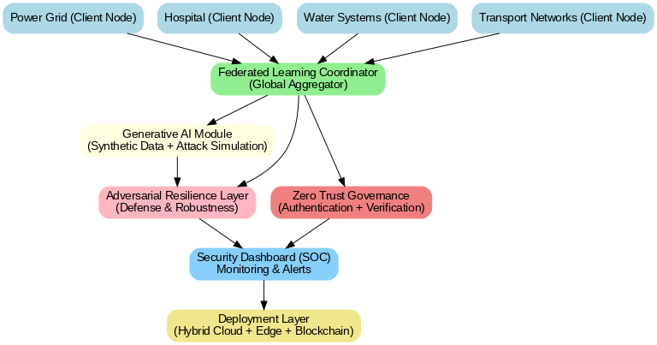
Architectural Diagram
Vel Tech High Tech Dr Rangarajan Dr Sakunthala Engineering College An Autonomous Institution
7

Slide 9
Future Enhancements (Phase 2)
Automated incident response
AI-powered threat prediction
Blockchain-based model update verification
IoT/Edge integration
AI explainability for transparent decisions
Vel Tech High Tech Dr Rangarajan Dr Sakunthala Engineering College An Autonomous Institution
8

Slide 10
Novelty of Our Project
Hybrid Federated AI: Global intelligence with local privacy
Adversarial Resilience: Defends against AI-targeted hacks
Zero Trust Governance: Eliminates blind trust
Generative AI: Simulates realistic attacks for training
Critical Infrastructure Focus: Tailored for high-impact sectors
Vel Tech High Tech Dr Rangarajan Dr Sakunthala Engineering College An Autonomous Institution
9

Slide 11
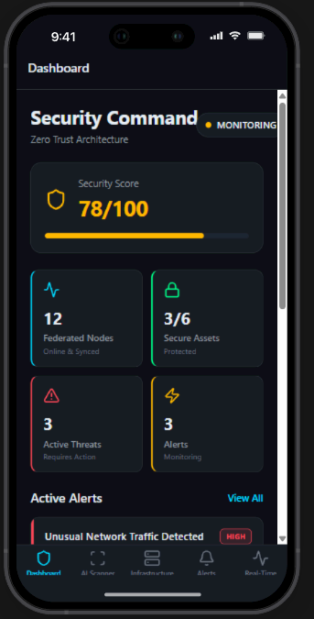
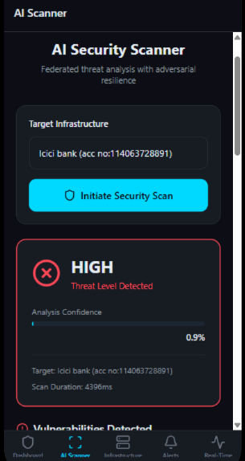
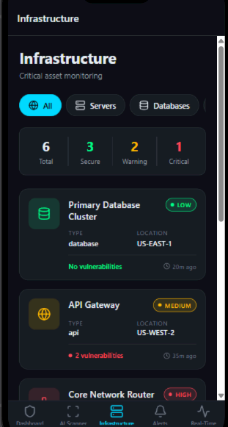
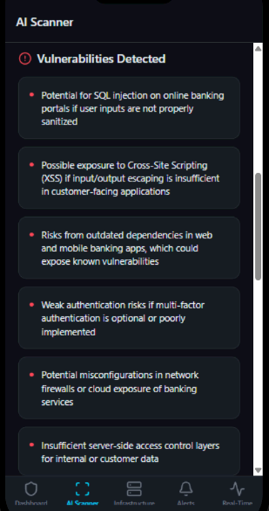
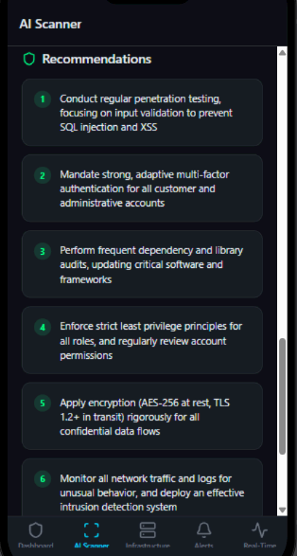
OUTPUT
Vel Tech High Tech Dr Rangarajan Dr Sakunthala Engineering College An Autonomous Institution
9

Slide 12
Conclusion
This simplified simulation demonstrates how Hybrid Federated Generative AI can train models across multiple clients without sharing raw data, thereby improving privacy and security in critical infrastructure applications.
By introducing adversarial attacks and testing the model’s resilience, we can evaluate its robustness against malicious input manipulation.
Integrating Zero Trust Governance ensures that only authenticated and authorized clients participate in the training process, preventing insider threats and data poisoning.
Vel Tech High Tech Dr Rangarajan Dr Sakunthala Engineering College An Autonomous Institution
10

Slide 13

Thank you!!!
*

